Slide 1
INNOVATION PRACTICES
PROJECT DISCUSSION AND APPROACH

Slide 2
Mentor: Ms. A Bharathi
Team members:
Sanjai M
Soumen Saha
Manoj S
Indra Shekar G
Vivekanandan

Slide 3
TOPIC: Healthcare Document Data Capture
DESCRIPTION: Capture all invoice content and particulars in any type of invoices with any format.

Slide 4
Problems in solving the business case
Text extraction from any handwritten document tends to have problems when it comes to accuracy.
Handwriting is difficult to understand by humans.
Difficult in recognizing similar characters.
Joined -up writing
instance, an ‘r’ and an ‘n’ → an ‘m’.
Different orientation in camera angle

Slide 5
Dataset available
The main resource for training the handwriting recognition model is the IAM Handwriting Dataset. This dataset contains handwritten text of over 1500 forms, where a form is a paper with lines of texts, from over 600 writers, contributing to 5500+ sentences and 11500+ word.
This database given its breadth, depth, and quality tends to serve as the basis for many handwriting recognition tasks and for those reasons motivated our choice of the IAM Handwriting Dataset as the source of our training, validation, and test data for our models.

Slide 6
Image preprocessing techniques
OpenCV is used to find structures in the images to automatically break the images into printed segments and handwritten segments.
OpenCV to find lines between sections, and use the coordinates of the lines to break the image into segments. OpenCV has a function called getStructuringElement(). We can define the structure type as a rectangle (“MORPH_RECT”), minimum width, and height of the rectangle to find horizontal lines.

Slide 7
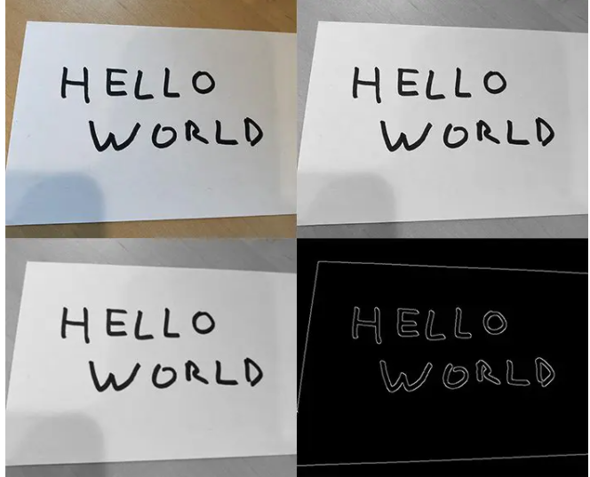
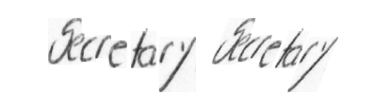
The IAM dataset consists of images of single words only. So the following pre-processing methods can be done in the dataset:
Padding images
Rotating images
Zero-centering image data
Blurring, morphing, edge detection and grayscale conversion

Slide 8
Existing technologies and models for handwritten text recognition
Tesseract OCR
Google’s cloud vision
VGG-19
RESNET-18
RESNET-34
Convolutional Recurrent neural Network (CRNN)

Slide 9
Implementation and accuracies achieved
Tesseract OCR:
Tesseract is a OCR engine developed for printed text extraction. So, for handwritten text recognition, it is more challenging because of the high variation in the handwriting styles from person to person. Hence Tesseract can not achieve satisfying results unless the texts are hand-printed.
Hence the next improvement for the model should be in capturing the features and varying patterns in different handwriting styles.

Slide 10
2. Google’s Cloud Vision:
Google Cloud Vision is an API from google for extracting handwritten text. Cloud Vision offers pre-trained machine learning models which are very powerful and we do not need any pre-training. Since it is specially made for handwritten text recognition, it will do a much better job in extracting text from images than Tesseract.
3. Recurrent Convolutional Neural Network:
CRNN is a combination of CNN, RNN, and CTC (Connectionist Temporal Classification), loss for image-based sequence recognition tasks, such as scene text recognition tasks and OCR. This neural network architecture integrates feature extraction, sequence modelling, and transcription into a unified framework.

Slide 11
4. VGG-19:
VGG-19 is a 19-layer deep Convolutional Neural Network (CNN). It is pre-trained model trained on more than a million images from the ImageNet database.
5. RESNET-18:
RESNET is a 18-layer deep Convolutional Neural Network used for object detection.
6. RESNET-34:
RESNET-34 is a 34 layer Convolutional Neural Network that can be utilised as a state-of-art image classification model.

Slide 12

On training with a dataset containing 4000 unique words, here are the accuracies of the VGG-19, RESNET-18 and RESNET-34 models:

Slide 13
Our Approach
To create character and word based neural network models using the available datasets like IAM dataset. Evaluate the models with their accuracies and picking the best one.
Preprocess the input image using OpenCV and converting it into a formatted digital document using the model we created.
Then extracting the whole text from the digital document using existing models like pytesseract, vision, etc.
The extracted text is converted into structured text using NLP and topic modelling techniques.

Slide 14
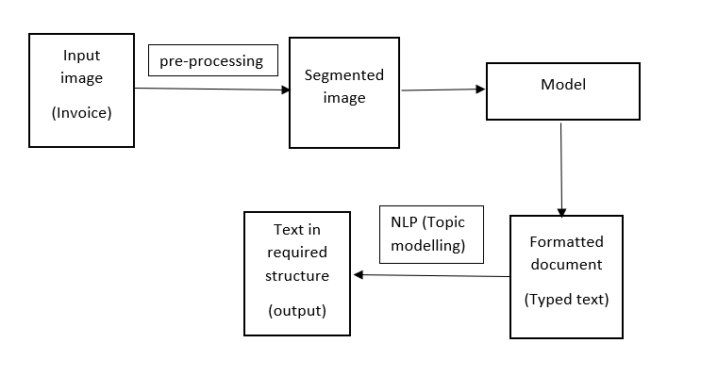
Workflow

Slide 15
THANK YOU

